Slide 1
War Strategy : 1939-1941
Course: Diplomatic History 1914-1945

Slide 2
Introduction
Three years of mounting international tension - encompassing the Spanish Civil War, the Anschluss (union) of Germany and Austria, Hitler's occupation of the Sudetenland and the invasion of Czechoslovakia - culminated in the German invasion of Poland
Second world war started on 1st September 1939 when Germany attacked Poland and lasted till 1945. Two days after German attack,
The principal belligerents were the Axis powers—Germany, Italy, and Japan—and the Allies—France, Great Britain, the United States, the Soviet Union.

Slide 3
Opening Moves: September 1939- December 1940
In September 1939, German forces under Adolf Hitler bombard Poland on land and from the air
The poles were swiftly defeated because of German war tactics including blitzkrieg and use of Luftwaffe ( German Air force)
Germany's blitzkrieg approach was characterized by extensive bombing early on to destroy the enemy’s air capacity, railroads, communication lines and munitions dumps, followed by a massive land invasion with overwhelming numbers of troops, tanks and artillery.
The Luftwaffe was an instrumental component of the Blitzkrieg battle plan. The Polish Air Force was defeated in just over two weeks. In addition to it, Russia also invaded eastern Poland, and eventually on 29th September 1939, Poland was divided between Germany and USSR

Slide 4
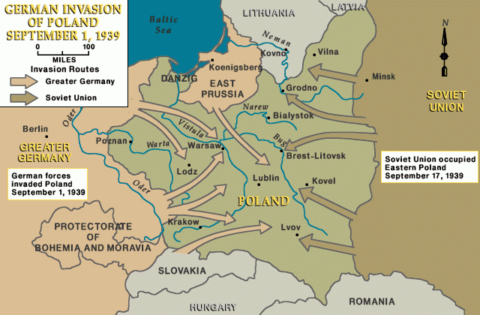
German Invasion of Poland: 1939

Slide 5
Opening Moves: September 1939- December 1940
Period of Phoney War
The Phoney War was an a period of time at the beginning of World War II in which no fighting occurred between Nazi Germany and Britain or France. World War II began on September 1st, 1939 when Germany invaded Poland. Although, Britain and France declared war against Germany a few days later, no fighting occurred in Western Europe until Germany's invasion of France during the Battle of France in May of 1940
On the eastern front, Russia took control of Estonia, Latvia, Lithuania and Finland. It was an attempt by Russians to secure any attack from the western front

Slide 6
Opening Moves: September 1939- December 1940
German attack on Norway and Denmark
German economy relied on over 11 million tons of iron ore imported from Sweden every year. During the warm months, there was little concern regarding the transportation of the ore into Germany, as the north-south railways were clear of snow, the Swedish Baltic ports free of ice, and the narrow entrance to the Baltic Sea sealed off to British warships. In the winter, however, the Swedish ore destined for Germany was forced to take a westward overland route into Norway, where it would board sea-going freighters for a southward coast-hugging voyage. This arrangement worked for as long as Norway stayed out of the war, which the Norwegian government desperately attempted to do. Germans wanted to occupy Denmark because it secured the communication lines to Norway during operation
Therefore, on 9th April 1940, Germany attacked on Norway and Denmark

Slide 7
Opening Moves: September 1939- December 1940
German attack on Belgium, Holland and France started at the western front in May 1940
Attack on Holland: The invasion, based on blitzkrieg , was swift and devastating. Holland surrendered six days later as her military had been unable to cope with the speed of blitzkrieg. The target was Waalhaven airfield to the south of Rotterdam (largest port in Europe)
Attack on Belgium: It was a neutral country until Germany decided to invade it. Germany didn’t wanted French or British troops occupying Belgium and therefore Hitler started the offensive
Attack on France: Main attack on France happened in the Ardennes (between German-Belgian-French border) on 13th May 1939.

Slide 8
Opening Moves: September 1939- December 1940
Battle of France: (May 10–June 25, 1940)
The trench warfare of World War I convinced the French that a strong defense would be crucial to stopping a future German invasion. So France constructed a series of fortifications known as the Maginot Line (the heavy blue line in the lower-right of the map here) that stretched along the common border between France and Germany. Hitler realized that a frontal assault on the Line would be counterproductive. Instead, in a repeat of German strategy from World War I, Germany attacked through Belgium and Holland, two small countries that lay north of France. The Germans soon reached the portion of the French border not protected by the Maginot Line. In just over six weeks, German armed forces overran Belgium and the Netherlands, drove the British Expeditionary Force from the Continent, captured Paris, and forced the surrender of the French government.

Slide 9
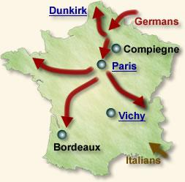
Opening Moves: September 1939- December 1940 --- French defeat in 1940

Slide 10
Opening Moves: September 1939- December 1940
Battle of Britain
The Battle of Britain in World War II was between Britain’s Royal Air Force (RAF) and the Luftwaffe, Nazi Germany’s air force. From July 10 through October 31, 1940, pilots and support crews on both sides took to the skies and battled for control of airspace over Great Britain, Germany and the English Channel.
The Germans in September started to bomb London. Germans lost 1389 plans and Britain lost 792 planes. Eventually Hitler called off the invasion. The main reasons of British success includes the inclusion of new radar stations and the lack of capacity within the German airforce

Slide 11
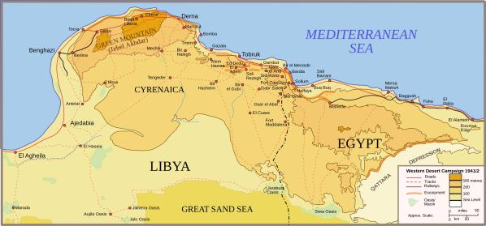
Opening Moves: September 1939- December 1940
Italian invasion of Egypt--- Extension of WWII outside European continent
The Italian invasion of Egypt in WWII lasted from September 13 to September 16, 1940, and was a strategic military operation against the British army for the purpose of invading and seizing Egypt during the North African campaign.

Slide 12
The Extension of Axis offensive: 1941 –1943
North Africa :
North Africa campaigns, (1940–43), in World War II was a series of battles for control of North Africa. At stake was control of the Suez Canal, a vital lifeline for Britain’s colonial empire, and of the valuable oil reserves of the Middle East. Hitler moved his troops in Libya and later in Egypt to help her ally- Italy in north Africa. In addition to it, they also advanced in Egypt, by 1942 Germans were in Egypt
Greece
The Battle of Greece (also known as Operation Marita, German: Unternehmen Marita) was a World War II battle that occurred on the Greek mainland and in southern Albania. The battle was fought between the Allied (Greece and the British Commonwealth) and Axis (Nazi Germany, Fascist Italy and Bulgaria) forces

Slide 13
The Extension of Axis offensive: 1941 –1943
Greece
In March 1941, a major Italian counterattack failed, and Germany was forced to come to the aid of its ally. Operation Marita began on April 6, 1941, with German troops invading Greece through Bulgaria in an effort to secure its southern flank. The combined Greek and British Commonwealth forces fought back with great tenacity, but were vastly outnumbered and outgunned, and finally collapsed. Athens fell on April 27. However, the British managed to evacuate about 50,000 troops. The Greek campaign ended in a quick and complete German victory

Slide 14
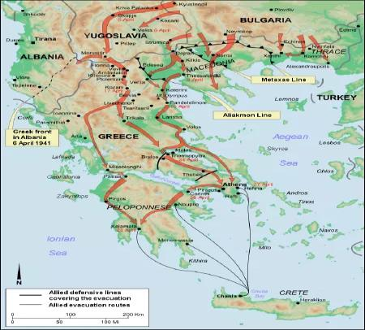
The Extension of Axis offensive: 1941 –1943

Slide 15
German Invasion of Russia – June 1941
Operation Barbarossa
On this day in 1941, over 3 million German troops invade Russia in three parallel offensives, in what is the most powerful invasion force in history. Nineteen panzer divisions, 3,000 tanks, 2,500 aircraft, and 7,000 artillery pieces pour across a thousand-mile front as Hitler goes to war on a second front.
Despite the fact that Germany and Russia had signed a “pact” in 1939, each guaranteeing the other a specific region of influence without interference from the other, suspicion remained high. When the Soviet Union invaded Rumania in 1940, Hitler saw a threat to his Balkan oil supply and moved the troops in Russia despite the fact that war at two fronts was a major turning point for german defeat in first world war

Slide 16
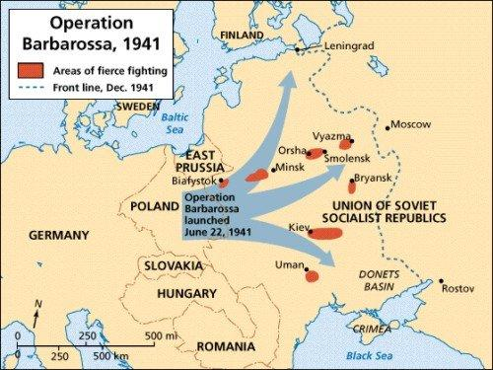
Operation Barbarossa

Slide 17
USA IN WWII-December 1941
In May 1940, the United States had made Pearl Harbor the main base for its Pacific Fleet. As Americans didn’t expect the Japanese to attack first in Hawaii, some 4,000 miles away from the Japanese mainland, the base at Pearl Harbor was left relatively undefended, making it an easy target
Japanese bombers hit all eight U.S. battleships, sinking four and damaging four others, destroyed or damaged more than 300 aircraft and killed some 2,400 Americans at Pearl Harbor on 7th December 1941. This incident not ony brought US into WWII but also extended the war in the Pacific theater
On December 8, 1941, the United States Congress declared war (Pub. L. 77–328, 55 Stat. 795) on the Empire of Japan in response to that country's surprise attack on Pearl Harbor the prior day

